Slide 1
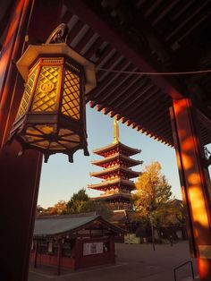
EDUCATION AND TOURISM SECTOR IN JAPAN
INVESTMENT OPPORTUNITIES IN THESE
TWO SECTORS

Slide 2
INTRODUCTION

Slide 3
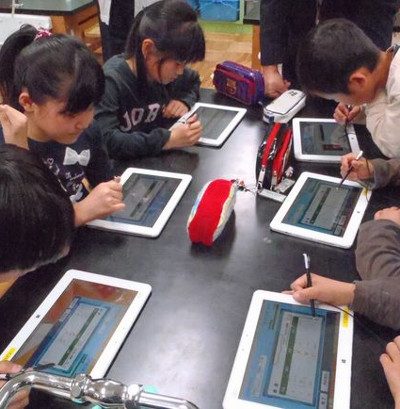
BENEFITS

Slide 4

OBSTACLES

Slide 5

PROFIT

Slide 6
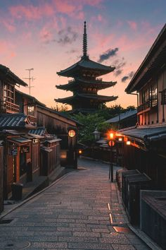
TOURISM

Slide 7
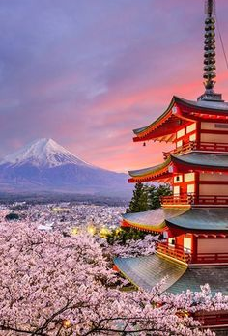
Benefits

Slide 8
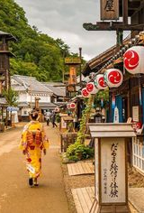
OBSTACLES.

Slide 9
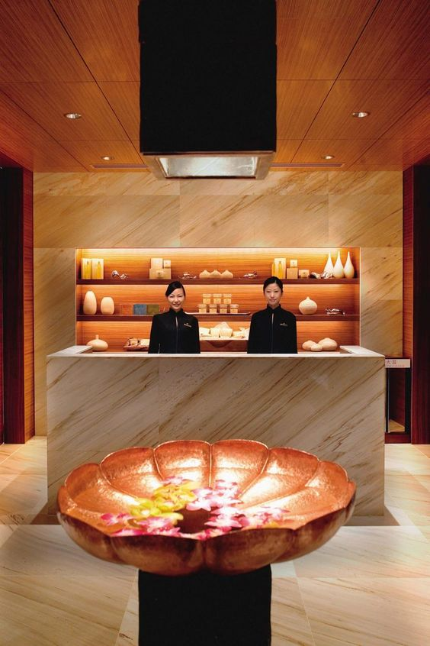
PROFIT

Slide 10
COMPARISON WITH CHINA
Both Japan and China receives many visitors for similar reasons such as food and culture but there are several differences too.
Japan has long history and honorary culture combined with modern technologies.
The same case it applies to the education system offered in the two countries they are different in that;
In Japan, one is allowed to decide a university of his choice, but in China, the case is different; a student is allowed to choose several universities hence not free to make a choice.

